Slide 1
Fan and Fill in the Safford Basin
Tye N Ropati
Mentor: Dr. Kelin Whipple
School of Earth and Space Exploration, Arizona State University
NASA Space Grant Symposium
April 19, 2025

Slide 2
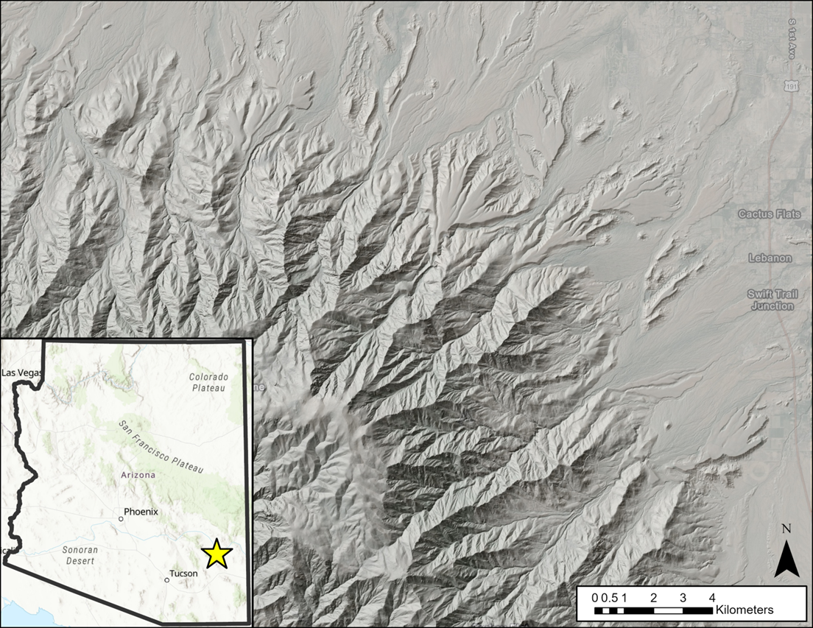
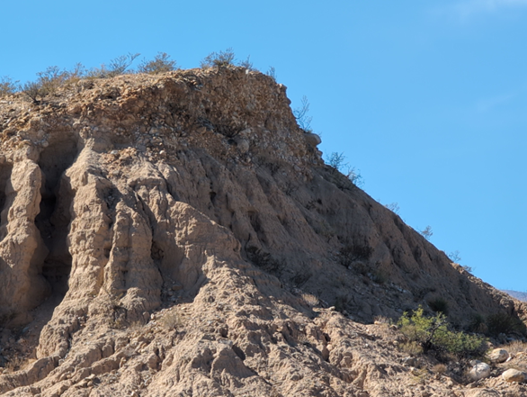
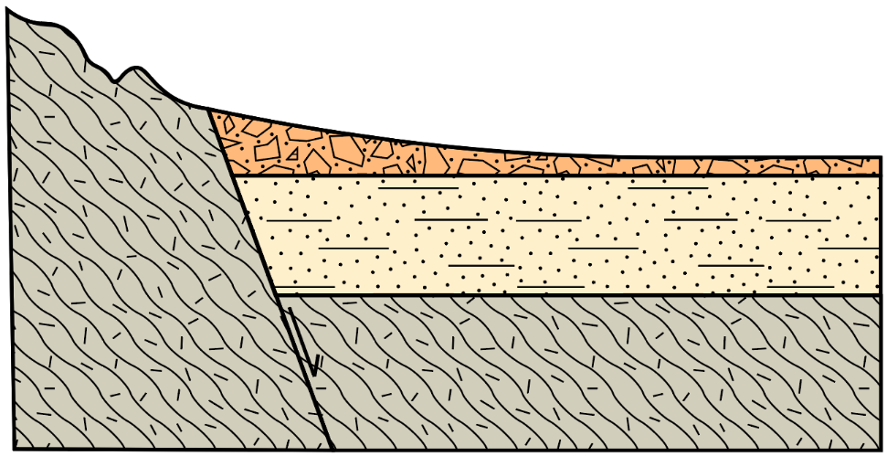
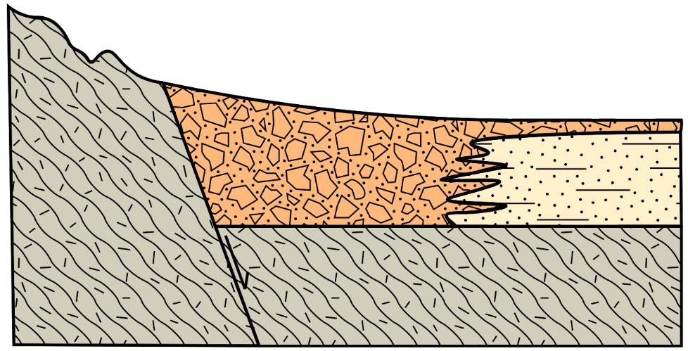

Background and Problem
Basin and Range extensional tectonics
  Closed basins to integrated river systems
Fine basin fill with thin gravel cap
  Relationship between facies?
Climate shift is long-standing hypothesis
Could it instead be depositional response?
Fig. 1 Fine basin sediments with capping gravels.
Fig. 2 Location map showing the Pinaleño mountains and Safford basin in southeastern Arizona.
a.)
b.)
Fig. 3 Cross sectional cartoons displaying expected relationship between basin fill and fanglomerate for the climate shift hypothesis (a) and the lateral facies hypothesis (b).

Slide 3
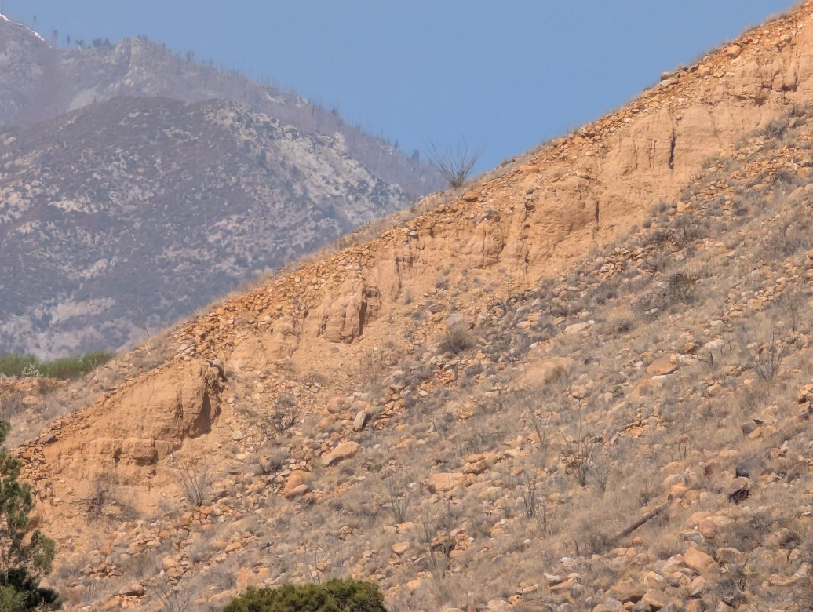
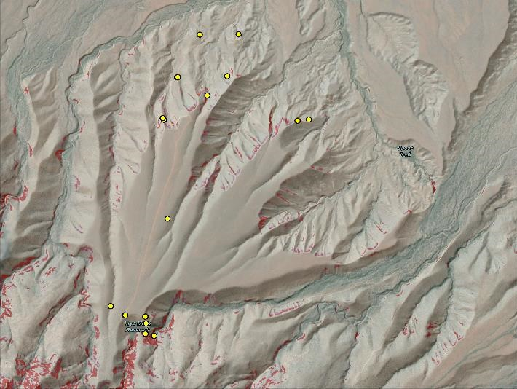
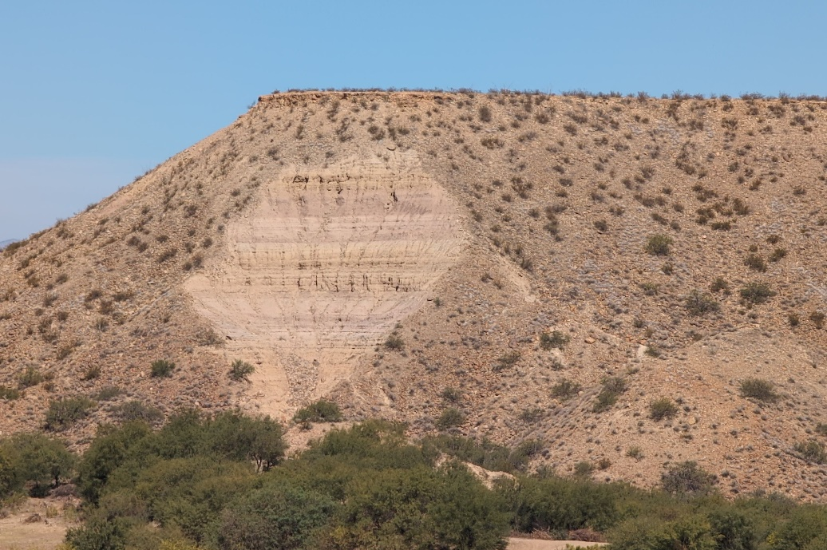
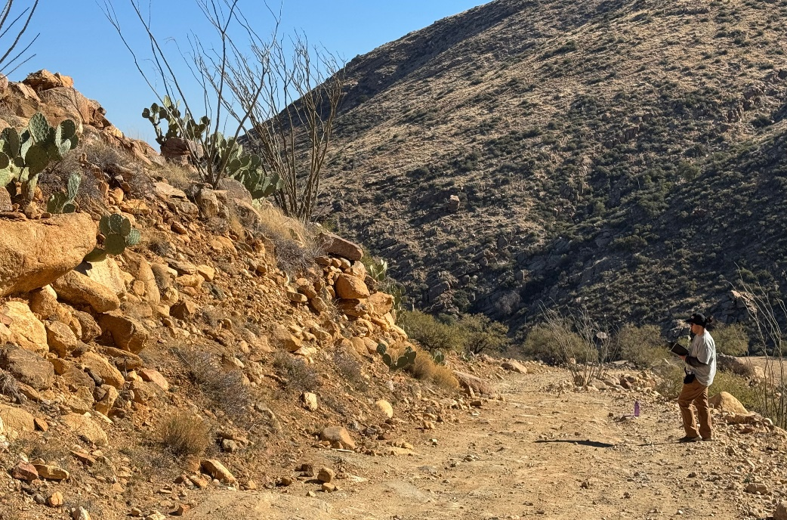
Methods
a.)
b.)
Exposure is necessary to characterize rock
GIS Analysis to search for possible exposures
Examination in the field
  Hiking
  Driving
  Binoculars
  Drone flights
c.)
d.)
Fig. 4 a.) Exposure of sandstones and colluvial boulder cover. b.) Hillshade map of Frye Mesa showing areas of high slope and observation points. c.) Exposed basin fill in landslide scarp. d.) Me examining conglomerate exposed along a roadcut.

Slide 4
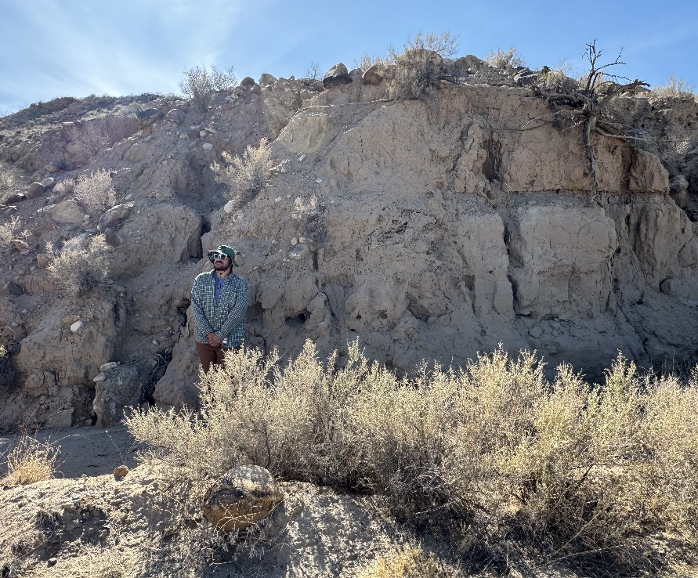
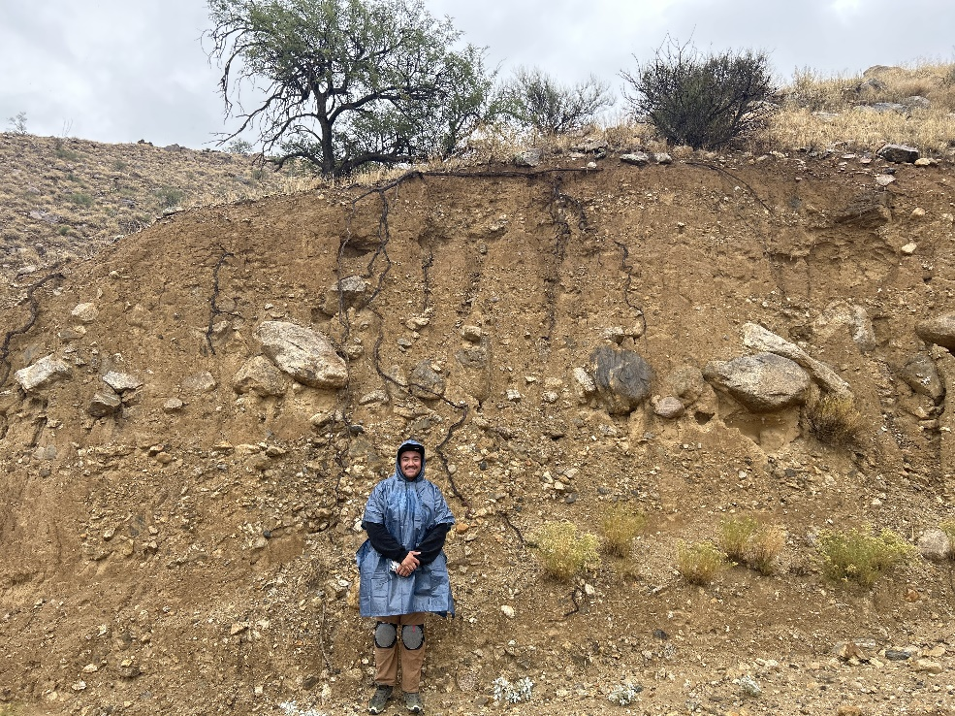
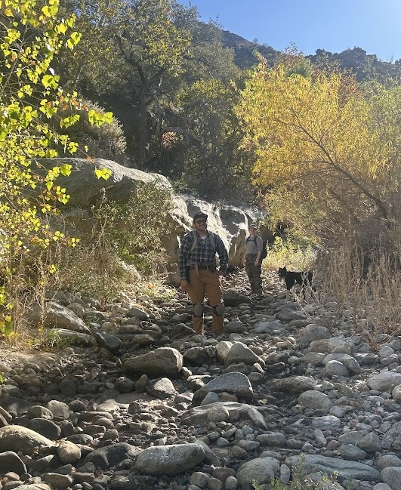
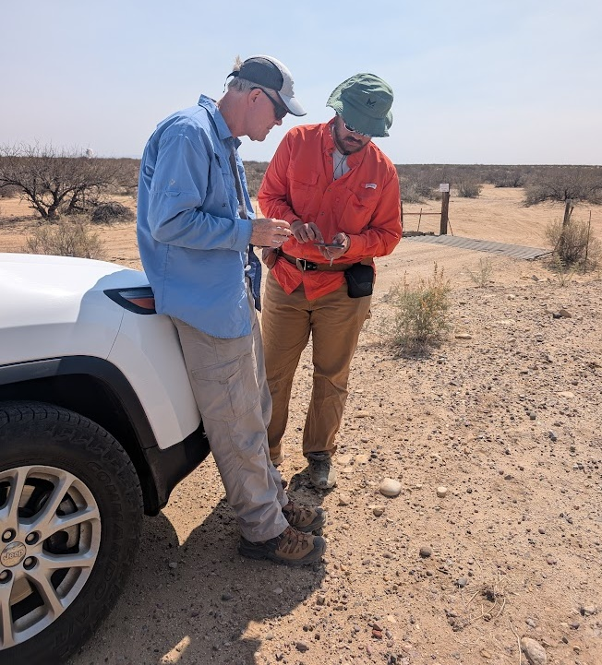
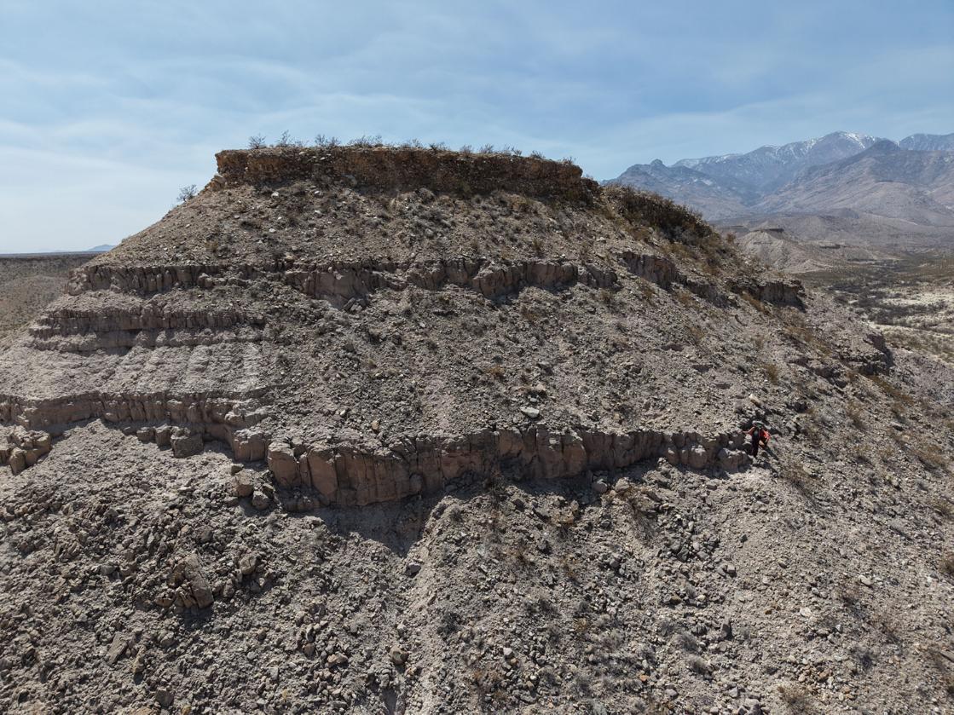
Fieldwork

Slide 5
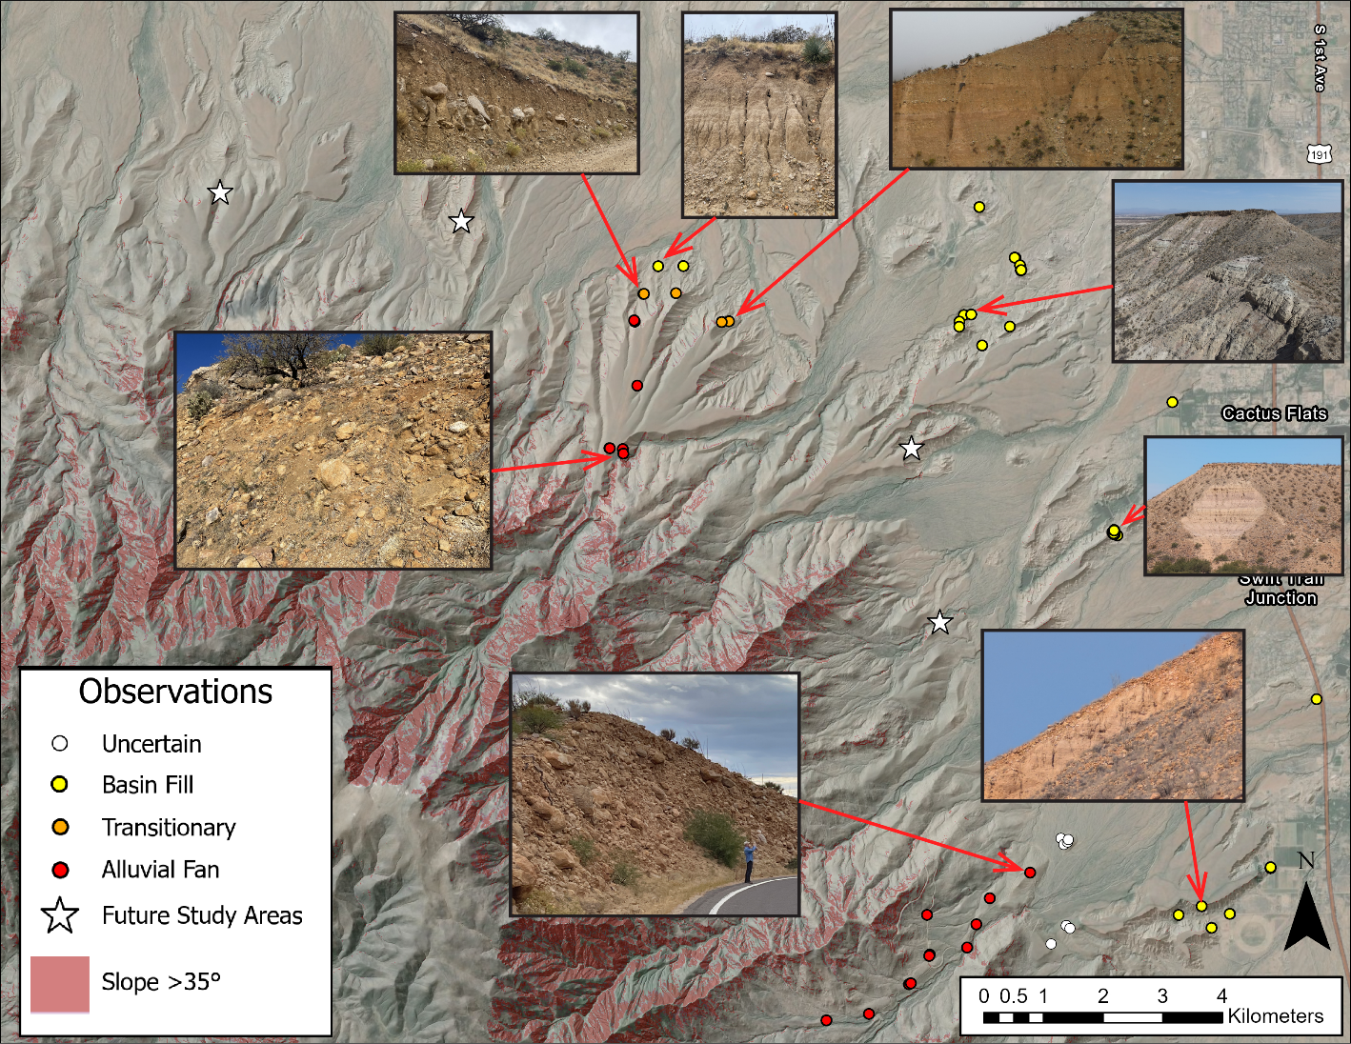
Results
Project is still in progress
Plotted field notes shown
Interpreted facies transition found at Frye Mesa
Facies relationships within the basin fill
Fig. 5 Hillshade map displaying points of observation colored according to interpreted lithofacies, with some images included. Areas with slope higher than 35° are displayed in red. White stars show key areas for future study.

Slide 6
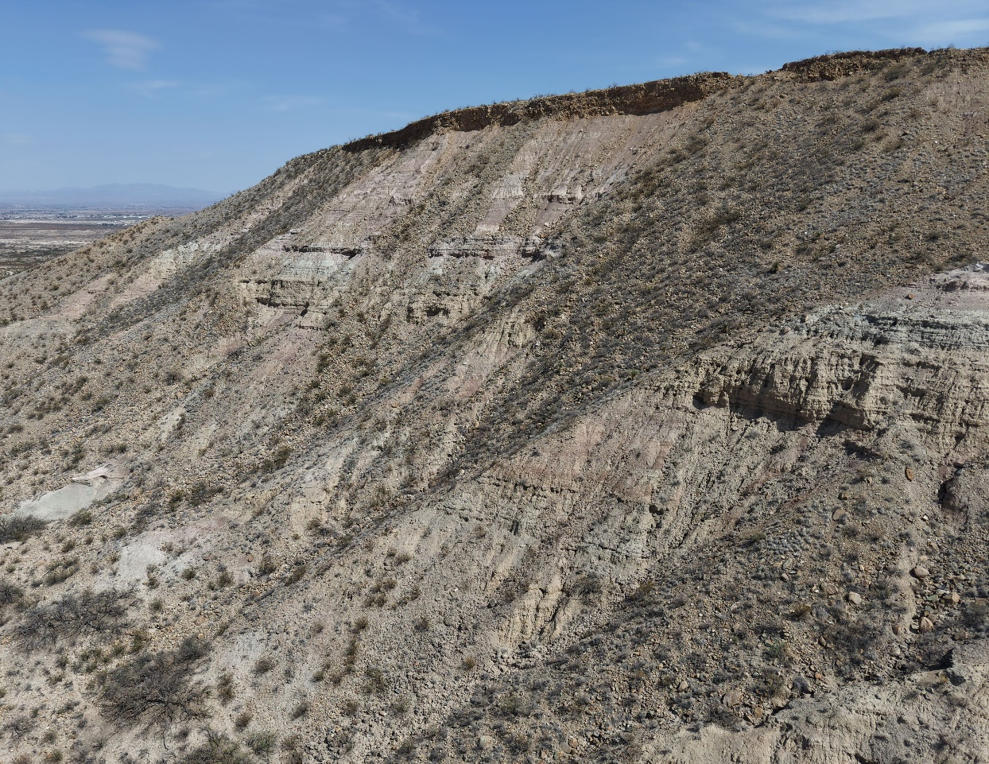
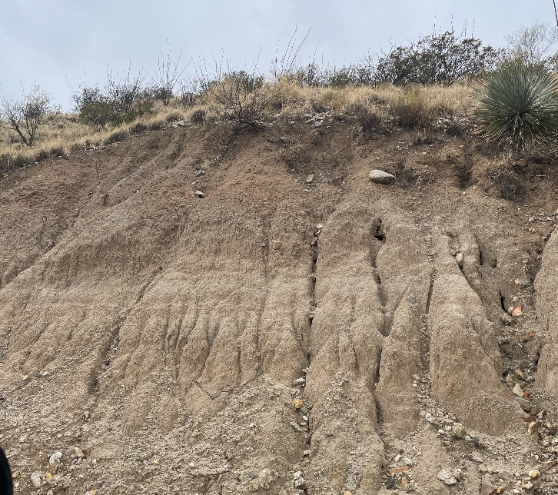
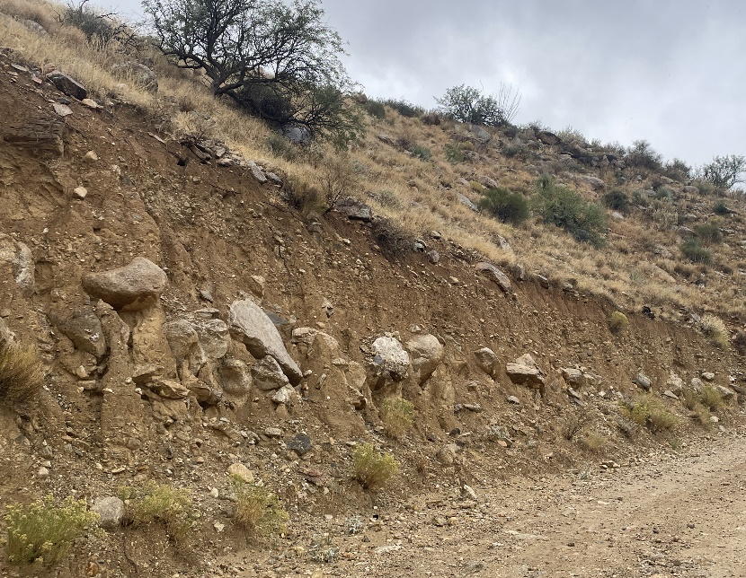
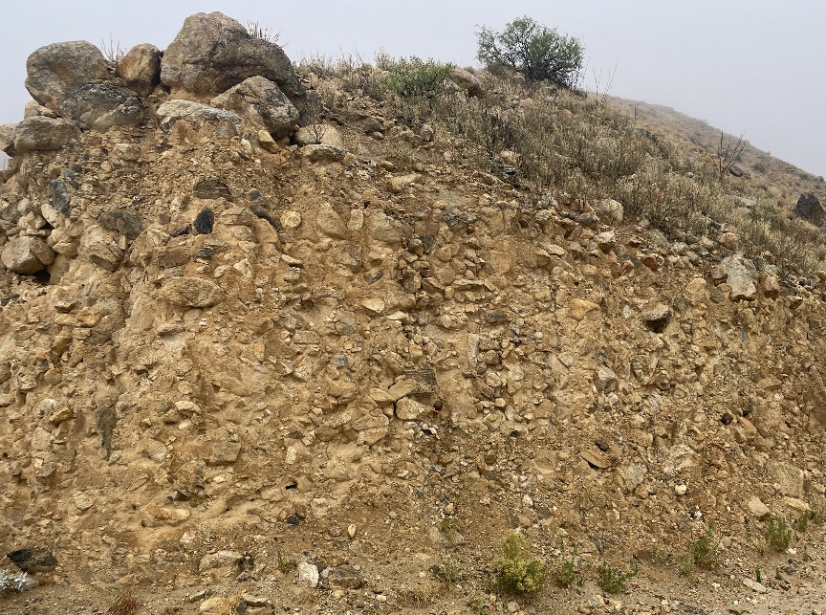
Interpretations
a.)
Interfingering between basin fill and alluvial fan in Frye Mesa
Progradation of deltaic/fluvial sandstone over lacustrine mudstone
  Intercalated → fluctuation of lake shore
Fig. 6 a.) Exposure of interbedded mudstones and sandstones capped by alluvial fan gravels. Sequence interpreted as progradation of deltaic/fluvial facies over lacustrine facies. b.) Images of exposures seen going up Frye Mesa Road from left to right. Images show progression from mudstone to interbedded mud, sand, and conglomerate to conglomerate.
b.)

Slide 7
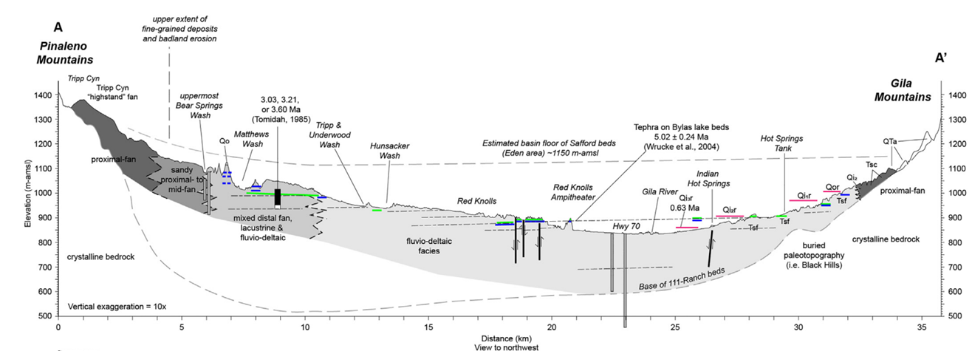
Interpretations
Results so far seem to support the lateral facies hypothesis
  Facies transitions
  Boulders deep into incised fans
Fig. 7 Cross section of the Safford basin depicting distribution and relationship of facies. Taken from Gootee et al., 2022.

Slide 8
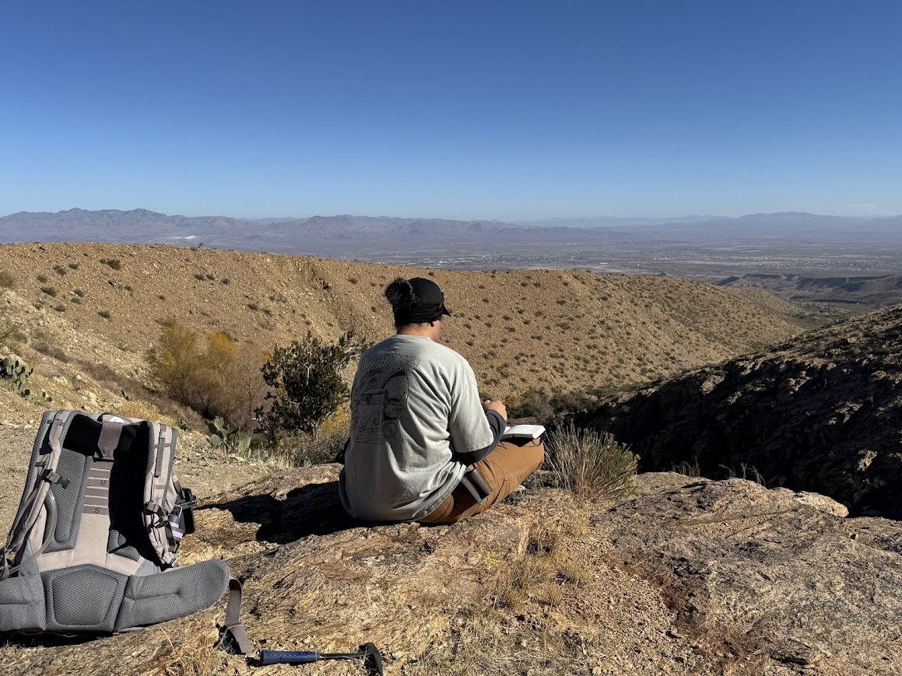
Future Steps
Trips to remaining incised fans
  Especially on the North side of the Pinaleños
  Look for more evidence of lateral variation in facies
Expand to other basins in Arizona
  Tonto basin is a prime target
  Is the pattern regional?
Fig 8. Me taking notes and sketching looking out into an incised drainage on Frye Mesa.

Slide 9




Acknowledgements
Thank you to NASA Space Grant and National Science Foundation (funding was provided by EAR-2229222 to K Whipple).
Thank you to Kelin Whipple for mentoring me, and to the members of my research group for assisting and providing support.

Slide 10
Thank You!
Questions?

